Slide 1
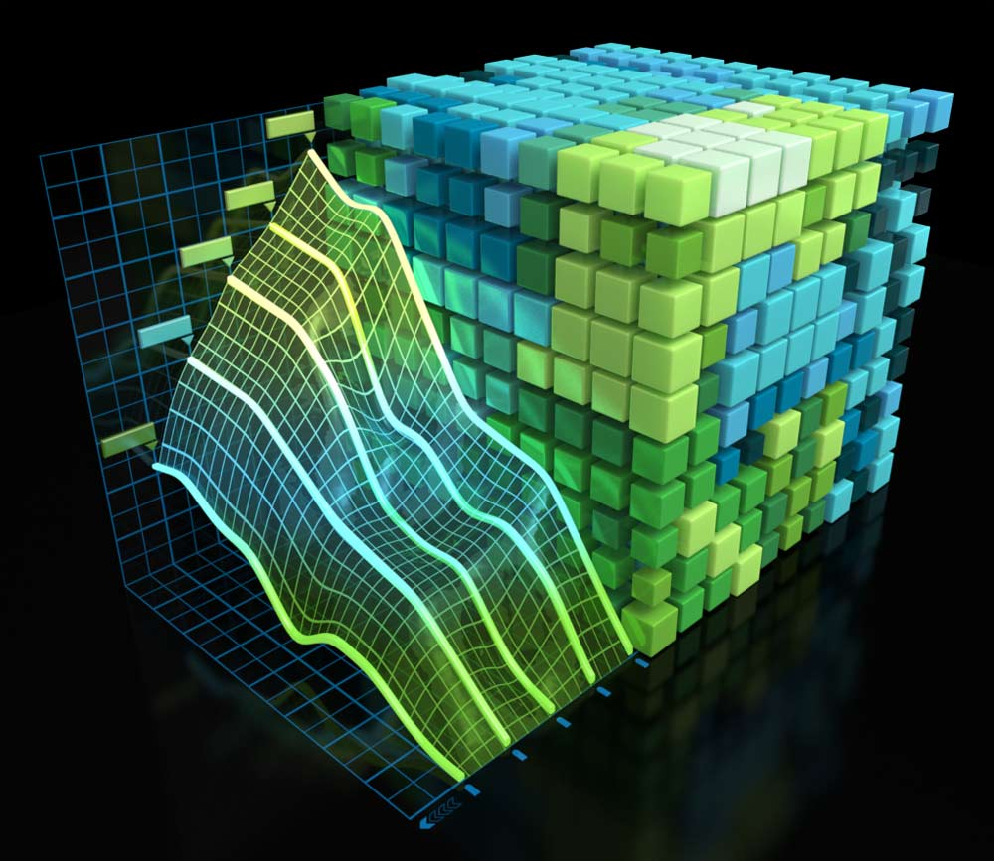
NVIDIA Profiler’s Guide
20163007
Sanghoon Kang

Slide 2
Outline
Introduction
  NVIDIA Profiler
  Necessity of the Profiler
User Guide
  nvprof
  Visual Profiler (nvvp)
  Analysis
Conclusion

Slide 3
Outline
Introduction
  NVIDIA Profiler
  Necessity of the Profiler
User Guide
  nvprof
  Visual Profiler (nvvp)
  Analysis
Conclusion

Slide 4
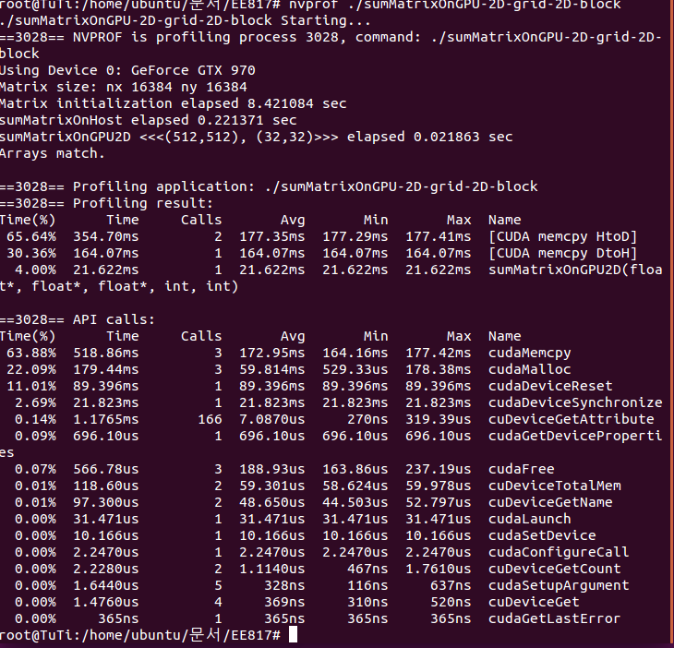
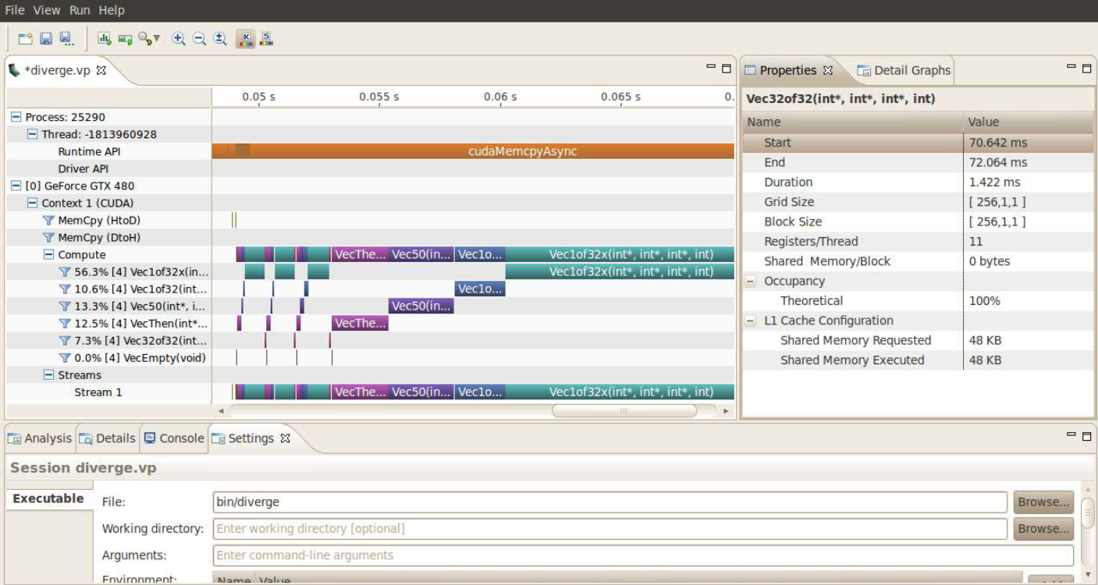
NVIDIA Profiler
1. Introduction
What is a Profiler?
  Tool that enables you to understand and optimize the performance of your CUDA applications
Types of NVIDIA Profilers
nvprof
Visual Profiler (nvvp)

Slide 5
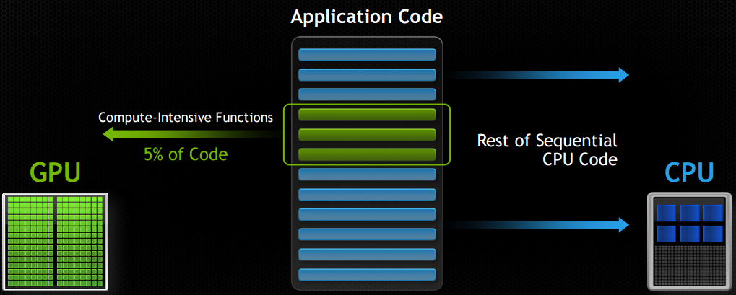
Necessity of a Profiler
1. Introduction
Application using both CPU & GPU
Performance Limiters
  Memory / Instruction bandwidth
  Latency of execution
➔ Need profiler to find out what limits the
application’s performance (speed)

Slide 6
Outline
Introduction
  NVIDIA Profiler
  Necessity of the Profiler
User Guide
  nvprof
  Visual Profiler (nvvp)
  Analysis
Conclusion

Slide 7
nvprof
2. User Guide
Terminal based profiler with textual reports
  Summary of GPU & CPU activity
  Trace of GPU & CPU activity
  Event collection
Usage of nvprof
  Terminal command
    $ nvprof [ nvprof_args ] <app> [apps_args]
  Argument help
    $ nvprof --help

Slide 8
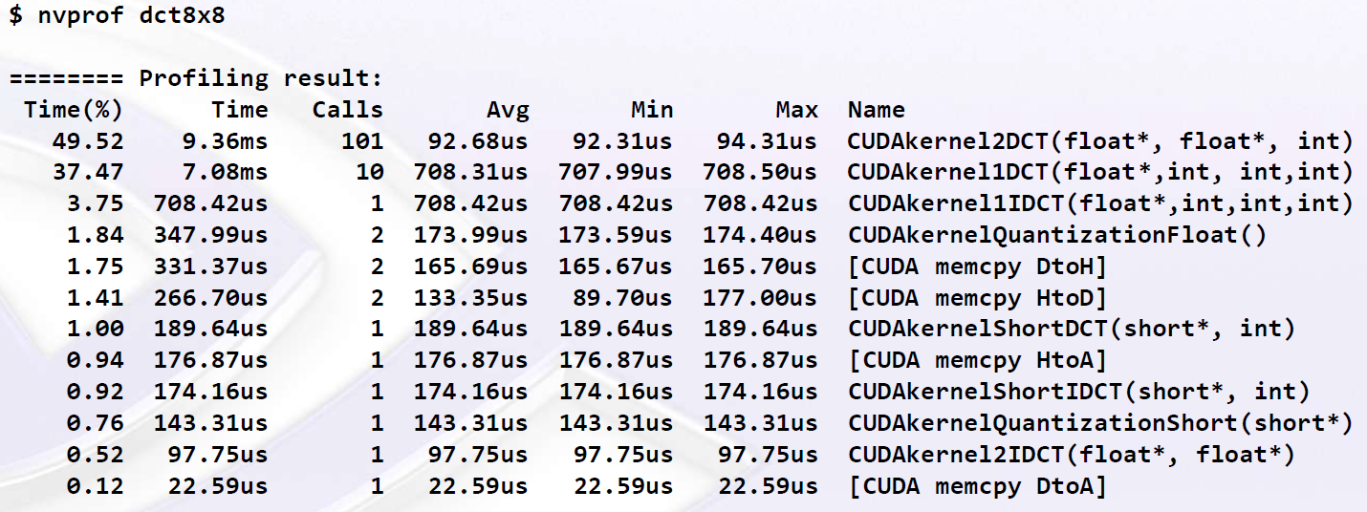
nvprof
2. User Guide
GPU Summary
  Summary of each kernel functions
    Number of calls
    Execution time (Avg, min, max)
    Time portion to the total application running time

Slide 9
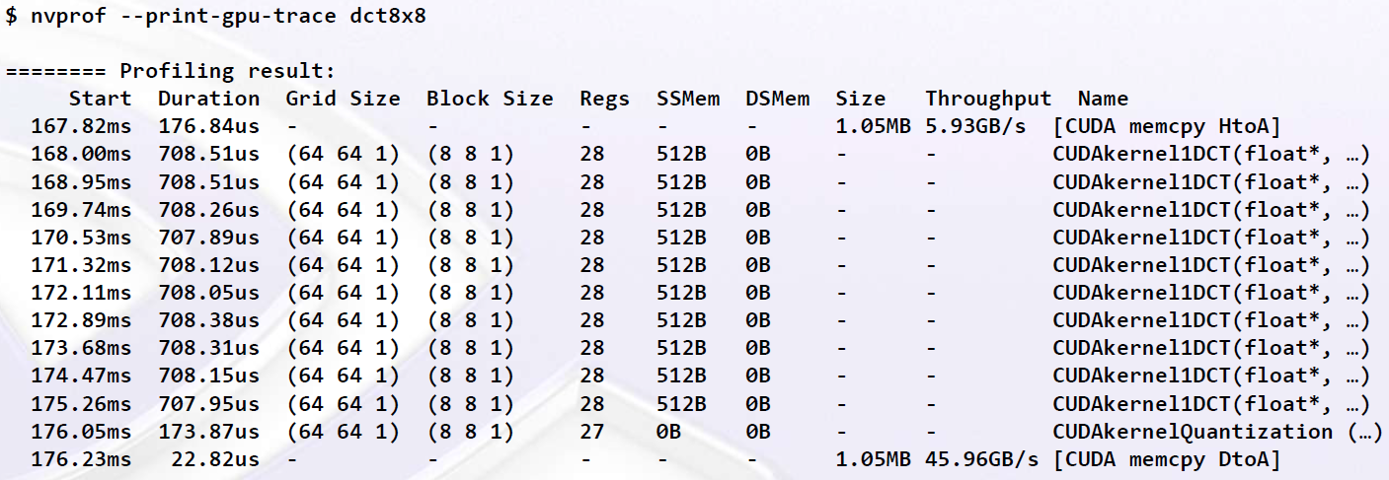
nvprof
2. User Guide
GPU Trace
  More detailed analysis
    Starting point, duration
    Grid & block allocations
    Size & Throughput of mempcy

Slide 10
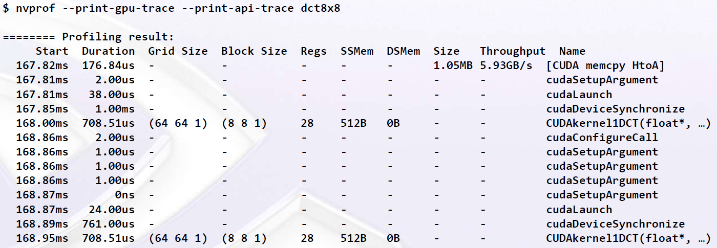
nvprof
2. User Guide
CPU / GPU Trace
  Enables API functions to be printed out
    Show internal kernel functions
    Synchronization between CPU & GPU

Slide 11
nvprof
2. User Guide
Profile Data Import / Export
  Produce profile data into a file
    $ nvprof -o profile.out <app> <app args>
  Import into nvprof to generate textual outputs
    $ nvprof -i profile.out
    $ nvprof -I profile.out --print-gpu-trace
    $ nvprof -I profile.out --print-api-trace
  Import into Visual Profiler
    Enables graphic user interface
    File menu → Import nvprof profile

Slide 12
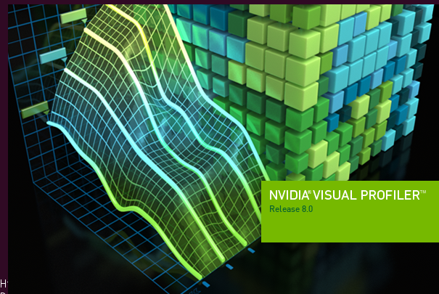
Visual Profiler
2. User Guide
Graphic User Interface (GUI) based profiler
  Standalone (nvvp)
  Integrated into NVIDIA Nsight Eclipse Edition (nsight)
  Nvidia Nsight Visual Studio Edition
Usage of nvvp
  $ nvvp

Slide 13
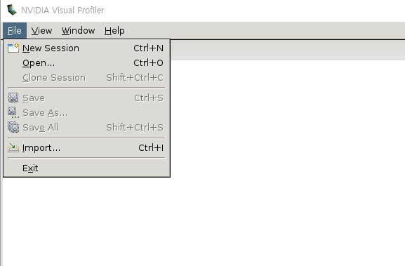
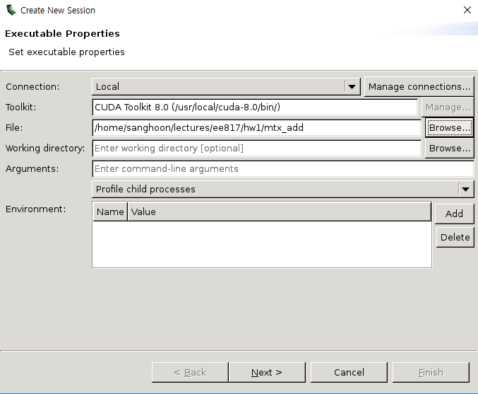
Visual Profiler
2. User Guide
Creating a New Session

Slide 14
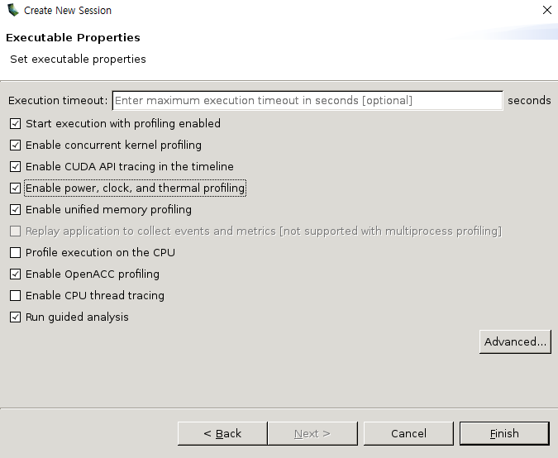
Visual Profiler
2. User Guide
Creating a New Session – Selecting Options

Slide 15
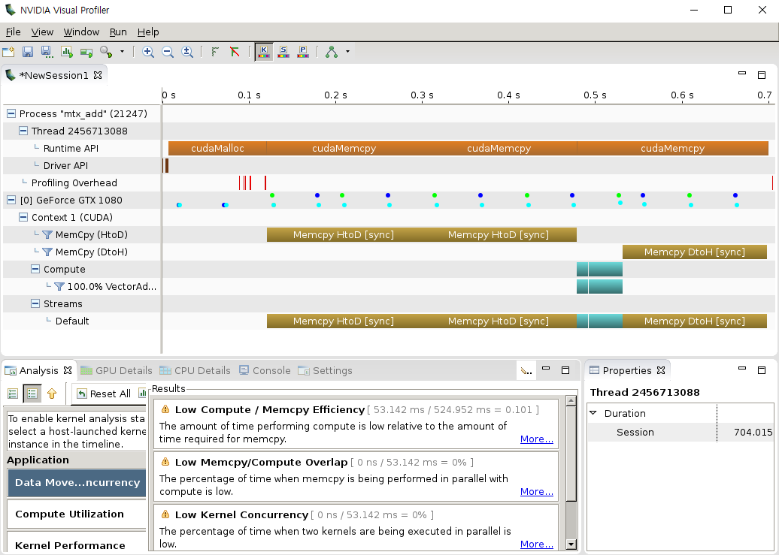
Visual Profiler
2. User Guide
Timeline

Slide 16
Visual Profiler
2. User Guide
Timeline - CPU

Slide 17
Visual Profiler
2. User Guide
Timeline - GPU

Slide 18
Visual Profiler
2. User Guide
Timeline - GPU

Slide 19
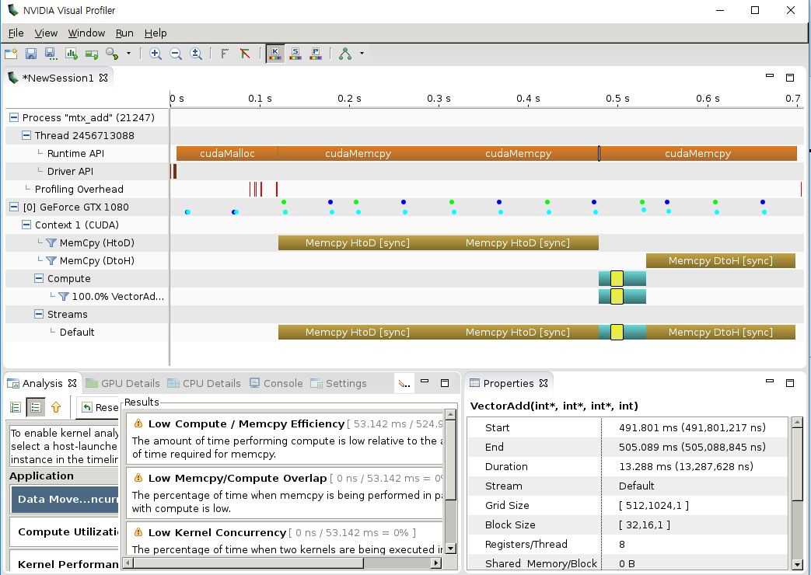
Visual Profiler
2. User Guide
Kernel Function Properties

Slide 20
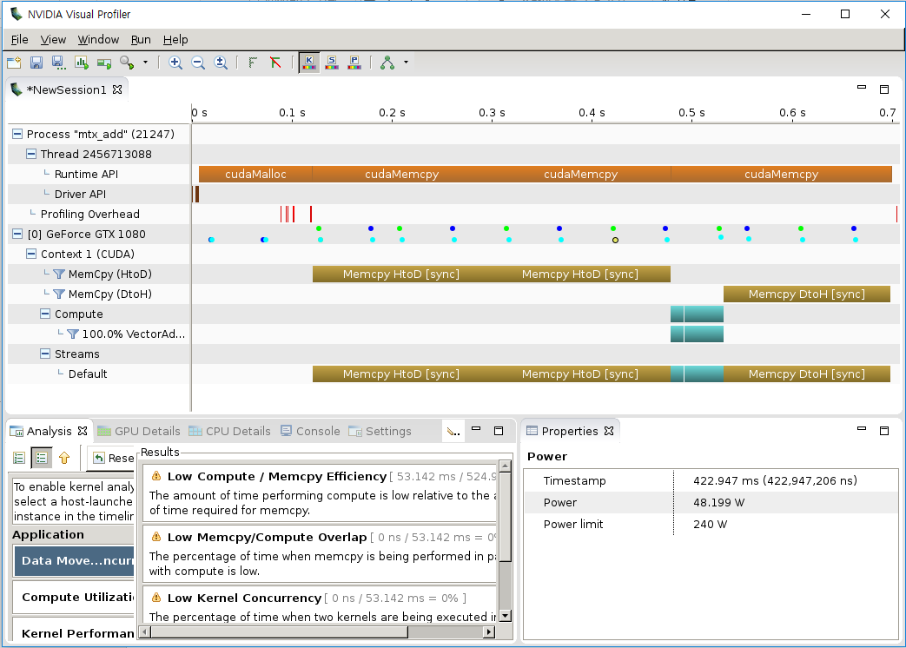
Visual Profiler
2. User Guide
Device Properties

Slide 21
Analysis
2. User Guide
Visual Inspection of Timeline
  Understand CPU / GPU interactions
    Is the application taking advantage of both CPU & GPU?
    Is CPU waiting on GPU? Is GPU waiting on CPU?
  Look for potential concurrency opportunities
    Overlap memcpy and kernel
    Concurrent Kernels

Slide 22
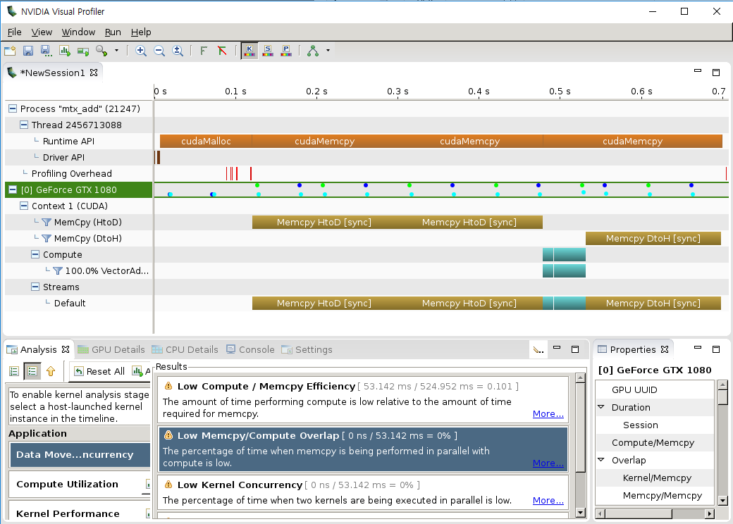
Analysis
2. User Guide
Automated Analysis

Slide 23
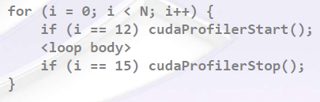
Analysis
2. User Guide
Focused Profiling
  Setting region of interest (ROI)
  Specify representative subset of app. Execution
    Manual exploration and analysis simplified
    Automated analysis focused on performance of ROI
  How to?
    cudaProfilerStart() / cudaProfilerStop() in the code
    Include cuda_profiler_api.h

Slide 24
Outline
Introduction
  NVIDIA Profiler
  Necessity of the Profiler
User Guide
  nvprof
  Visual Profiler (nvvp)
  Analysis
Conclusion

Slide 25
Conclusion
3. Conclusion
Goal of Using Profilers
  Find out performance limiters of
  data & computation intensive applications
  Optimal resource distribution across application
  Overlapping procedures ➔ Latency hiding
Tools for Profiling
  Nvprof
    Terminal based texture profiling
  Visual Profiler
    GUI based profiling with timeline

